Slide 1


For Beginner
By :- RAHUL JOGRANA
www.dotnetlab.in
www.aspnetinhindi.blogspot.com
Twitter:- @thejograna
Github:- github.com/rahuljograna
Part 2 Install ionic in windows

Slide 2

Tools for ionic
First, install Node.js. Then, install the latest Cordova and Ionic command-line tools. Follow the Android and iOS platform guides to install required platform dependencies.
Any Text Editor Can will Accept Like VS Code, Sublime, Atom, Eclipse, Notepad
I am using VS Code, you can use any text Editor.
https://www.ionicframework.com/getting-started/index.html.

Slide 3
Install ionic
$ npm install -g cordova ionic

Slide 4
Let’s Start

Slide 5
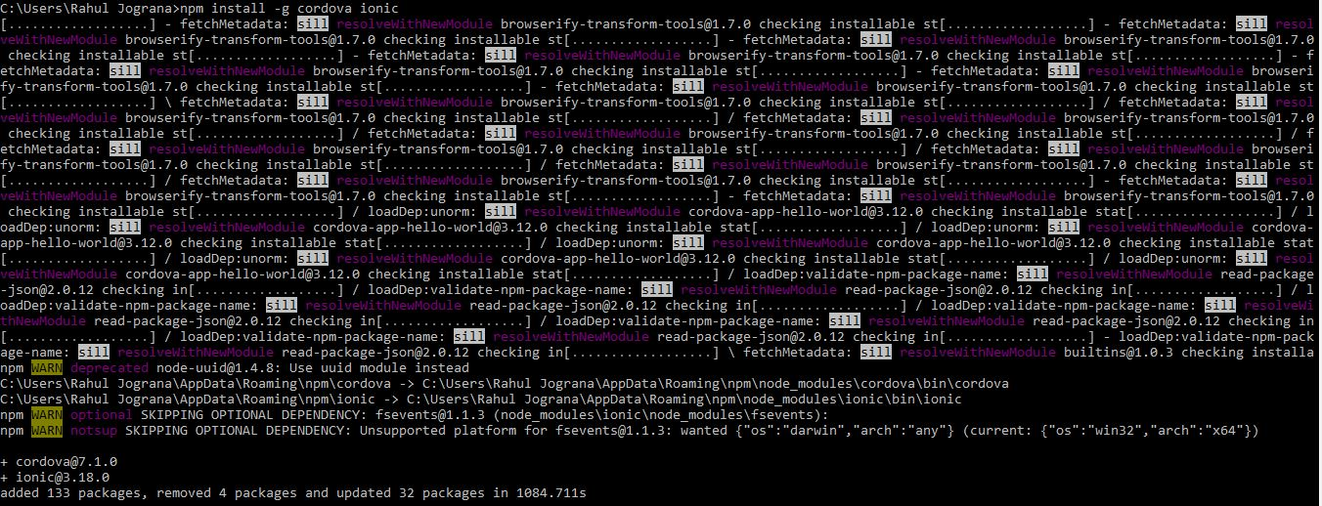

Slide 6
To learn new Technology along with Example like
ASP.NET, ASP.NET MVC, AngularJS, ASP.NET Web API
From Beginners visit my Youtube channel and steps and Source code is
Available on My Blog and Web site
Source Code :- http://aspnetinhindi.blogspot.com
Website :- http://www.dotnetlab.in
Github :- https://github.com/rahuljograna
Twitter :- twitter.com/thejograna
Mail :- rahuljograna007@gmail.com
WhatsApp Number :- 9426585554

Slide 7
To Develop Application
Contact me
Mail me : rahuljograna007@gmail.com
Mobile : +91 9426585554
whatsApp : +91 9426585554

